Slide 1
INVENTO LABS
INTERNSHIP EXERCISE
SABYASACHI PURKAYASTHA
M.TECH(GEOMATICS)

Slide 2
A. Distance traveled: total distance (unit: km) covered by each equipment on daily basis
STEPS:
Open dataset and parse ‘device_time_stamp’ field as a datetime object using Pandas
Clean undesired values from all columns. E.g strings were present within the ‘latitude_gps’ and ‘longitude_gps’ values
Removed all NaN values and 0 values occurring in ‘device_time_stamp’, ’device_id_x’, ’latitude_gps’, ’longitude_gps’
Created a list of unique ‘device_id_x’
For each element in the list, created a subset of the given dataframe
Sorted values by ‘device_time_stamp’
Using Pandas datetime accessor, selected all logged values from the subset day-wise.
Joined the point coordinates for each day to create a Shapely LineString and calculated its length.
Appended the device wise stats into a new data frame
After each element has been processed from step 6 to 10, we get the final dataframe that can be plotted to arrive at results for PART A.

Slide 3
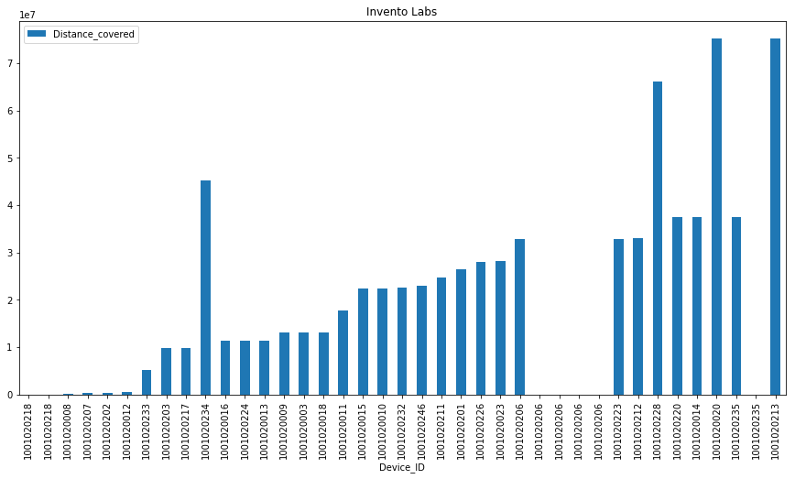
A. Distance traveled: total distance (unit: km) covered by each equipment on daily basis
Distance in meters
Device ID

Slide 4
B. ON time: total time (unit: hour) for which ignition of each equipment was ON (track_num1 = 1)
STEPS:
Created a list of unique ‘device_id_x’
For each element in the list, created a subset of the given dataframe
Sorted values by ‘device_time_stamp’
Using Pandas datetime accessor, selected all logged values from the subset day-wise.
Selected rows with track_num1 = 1 and thereafter counted the total ON seconds.
Appended the device wise ON stats into a new data frame
After each element has been processed from step 2 to 6, we get the final dataframe that can be plotted to arrive at results for PART B.

Slide 5
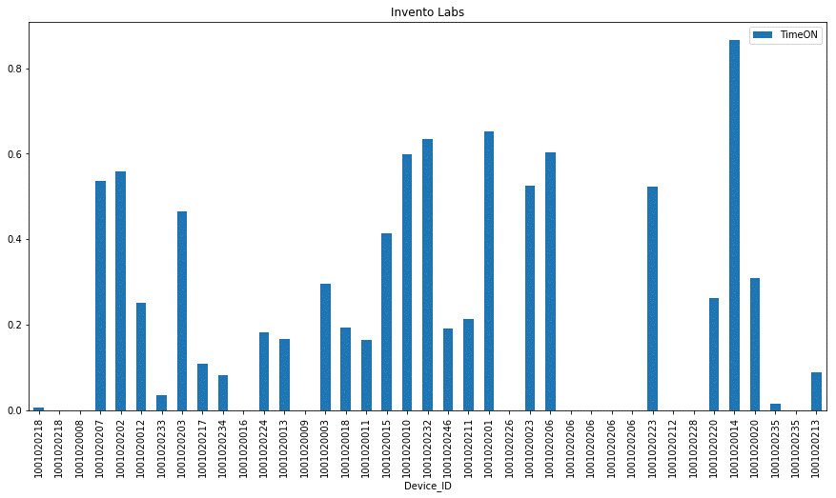
B. ON time: total time (unit: hour) for which ignition of each equipment was ON (track_num1 = 1)
Time in seconds
Device ID

Slide 6
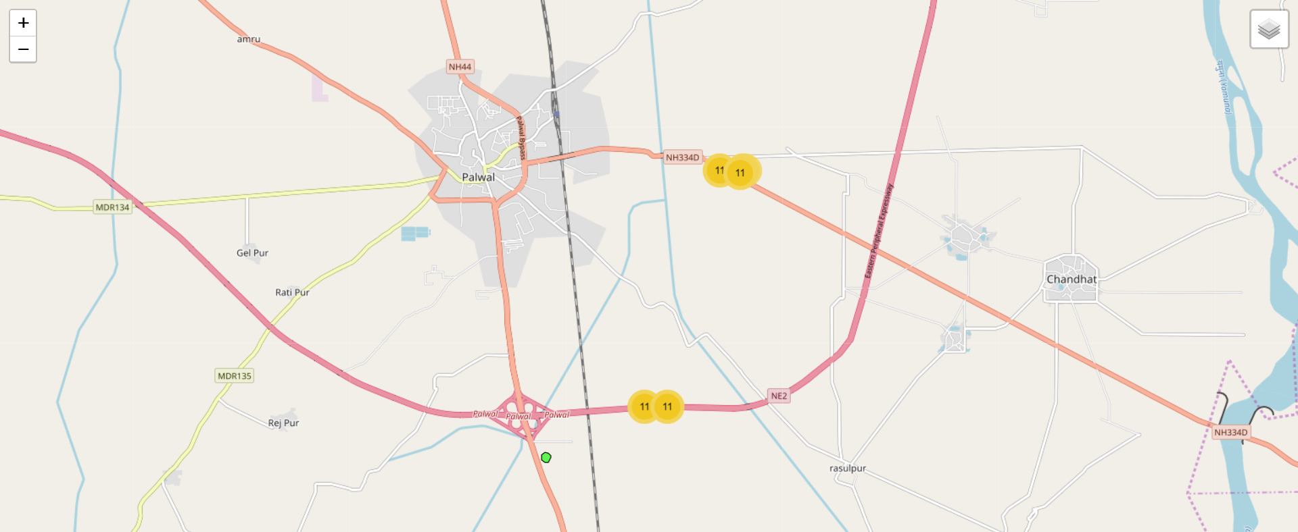
C. Equipment in the vicinity: if a main equipment is at the location of (latitude = 28.09029007, longitude = 77.33970642), provide a map (one map for each day) showing: a. geofence/circle of radius=100m around the main equipment; b. Equipment present inside fence between 9:00am and 9:10am (one map each day)
STEPS:
The device wise- per day wise dataframe generated for previous task was iterated using ‘geometry’ column and for each point we queried if it lied within the circular buffer around the main equipment
No results were found as none of the points intersected the buffer during the given time frame
points
Buffer region

Slide 7
B. Equipment in the vicinity: if a main equipment is at the location of (latitude = 28.09029007, longitude = 77.33970642), provide a map (one map for each day) showing: a. geofence/circle of radius=100m around the main equipment; b. Equipment present inside fence between 9:00am and 9:10am (one map each day)
STEPS:
Created a list of unique ‘device_id_x’
For each element in the list, created a subset of the given dataframe
Sorted values by ‘device_time_stamp’
Using Pandas datetime accessor, selected all logged values from the subset day-wise.
Selected rows with track_num1 = 1 and thereafter counted the total ON seconds using sum.
Appended the device wise ON stats into a new data frame
After each element has been processed from step 2 to 6, we get the final dataframe that can be plotted to arrive at results for PART B.

